Slide 1
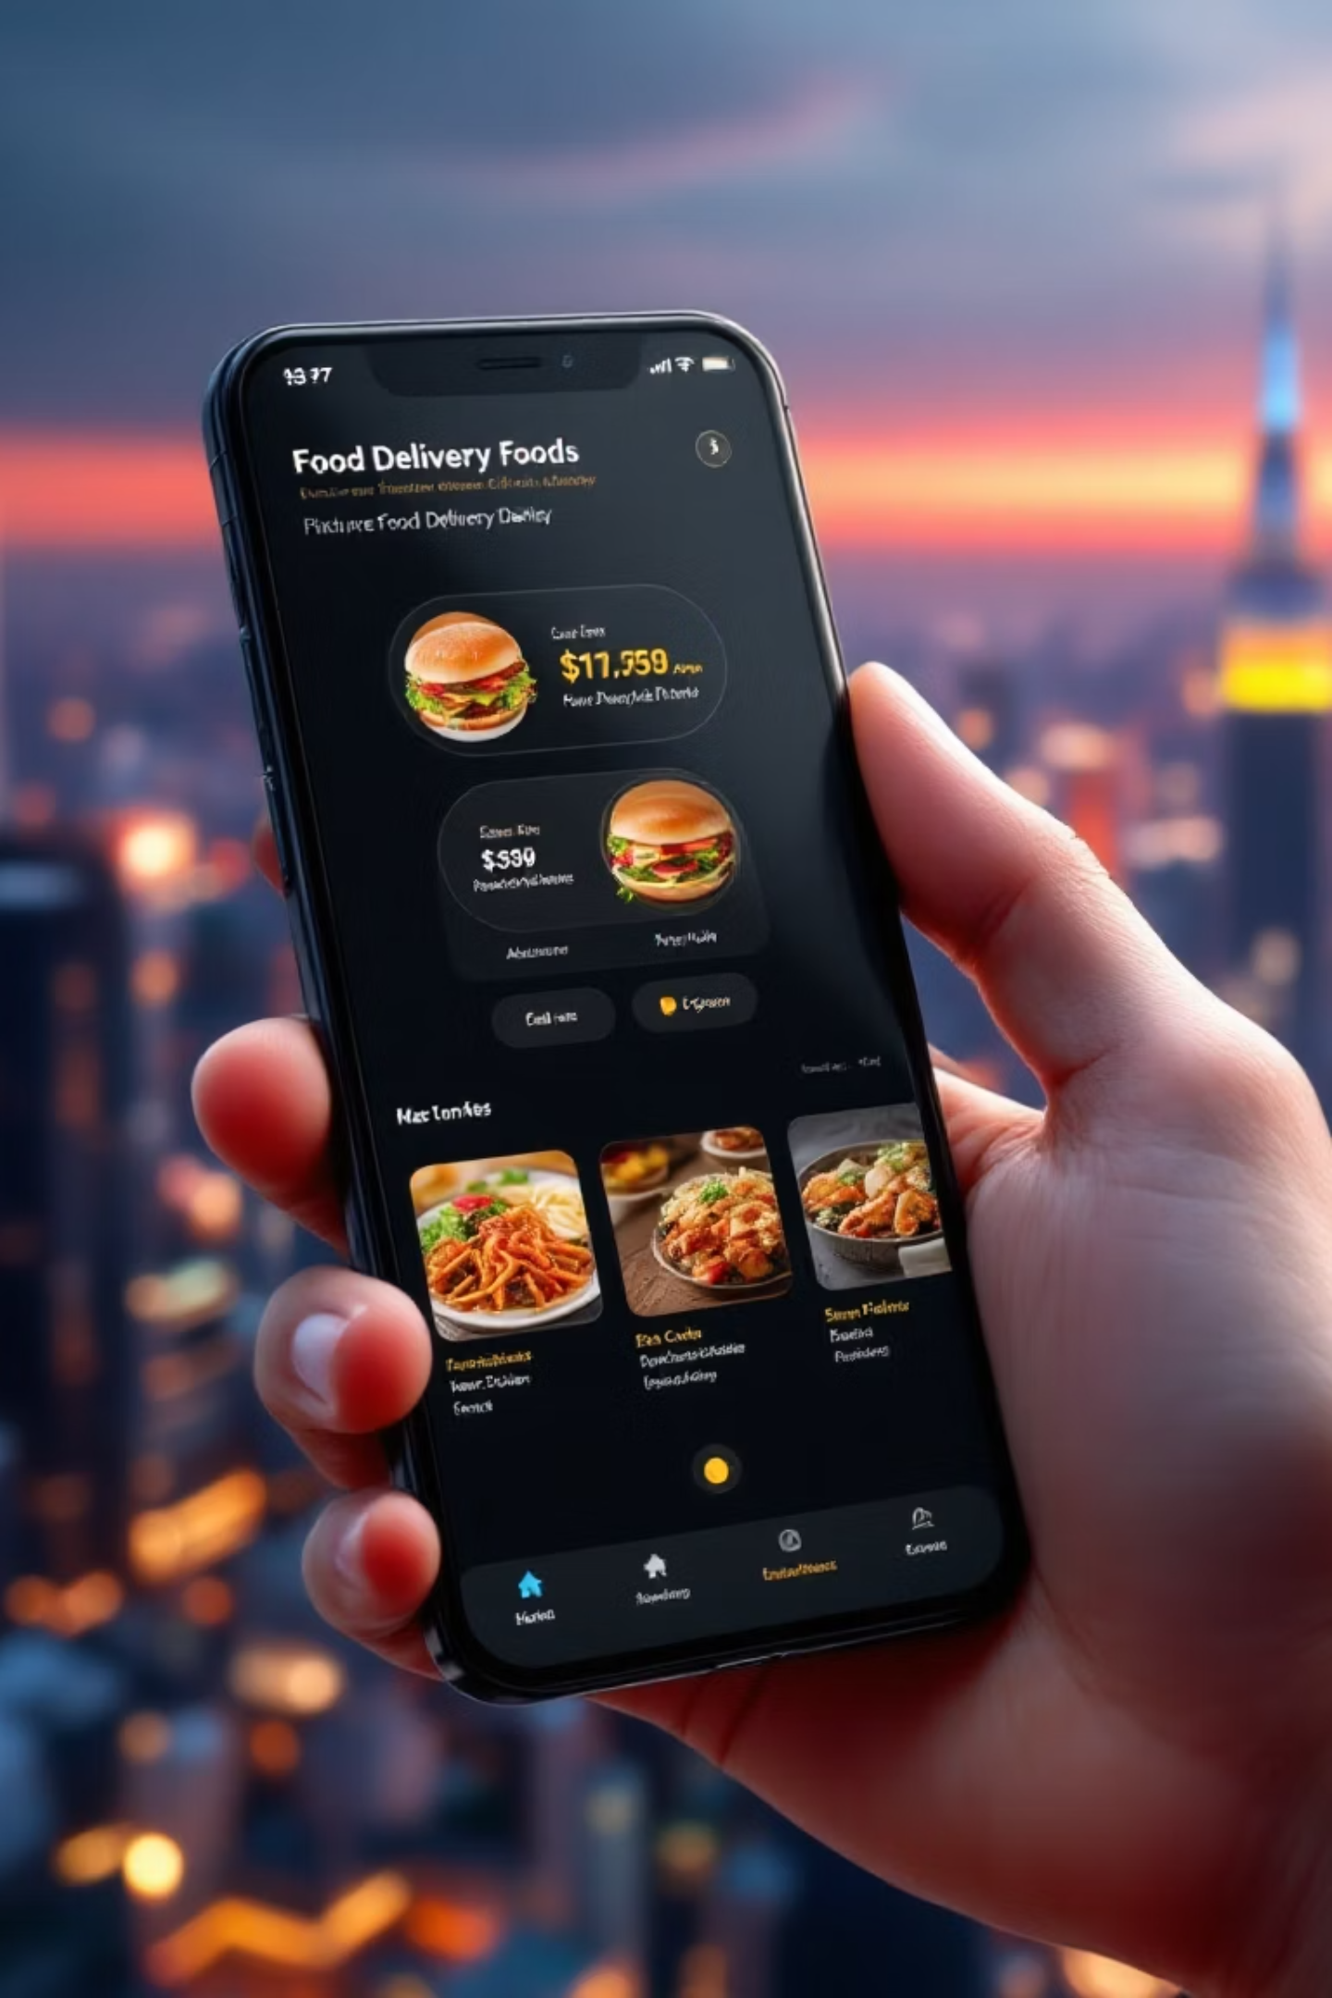


Quick Bite Crisis Recovery Analysis
QuickBite Express, a Bengaluru-based food delivery startup founded in 2020, faced a major operational crisis in June 2025. This comprehensive analysis uses Python EDA and Power BI visualization to understand the crisis impact on orders, customers, restaurants, and delivery partners—and chart a path to recovery.

Slide 2

The Crisis Impact
Order Decline
Sharp drop in monthly orders during crisis period
Delivery Delays
SLA performance dropped significantly
Customer Dissatisfaction
Ratings fell from 4.5 to 2.6
Restaurant Churn
Partners dropped out during crisis

Slide 3

Data Analysis Approach
Python EDA
Power BI Dashboard
8 datasets merged and cleaned
Interactive KPIs across 5 pages
318K rows analyzed
Phase-based comparisons
Feature engineering for crisis phases
Multi-dimensional insights
Recovery strategy tracking
Trend analysis and visualizations

Slide 4
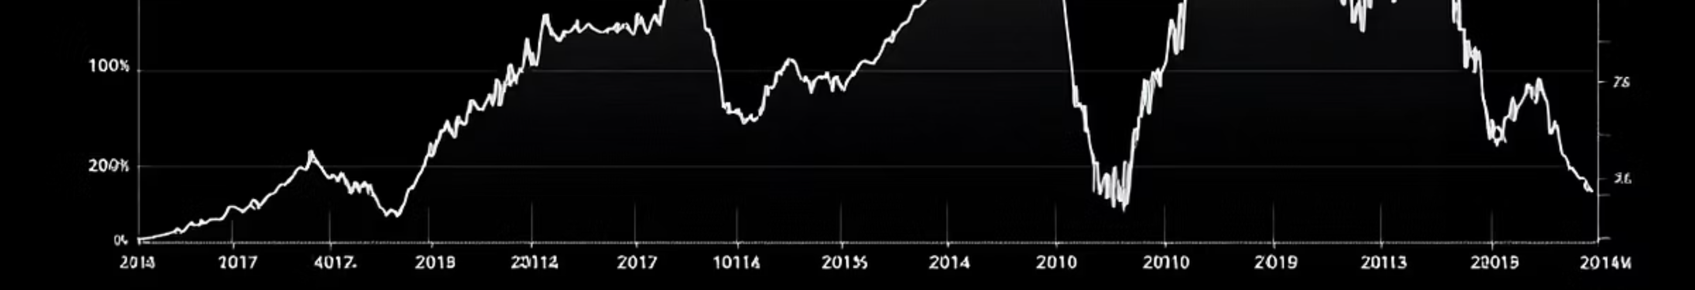
Revenue Collapse
Jan-Aug
Oct-Dec
Stable revenue performance
Strong recovery begins
1
2
3
September
Sharp drop during crisis peak
Crisis clearly impacted revenue, especially in September due to cancellations and delivery issues

Slide 5

Market Dominance by City
40K
23K
20K
Bengaluru
Mumbai
Delhi
Leading market with highest order volume
Second-tier market performance
Strong metro presence

Slide 6




Customer Behavior & Preferences
75%
22%
Organic Acquisition
Paid Campaigns
Strong brand pull and retention with ~75,000 orders
Contributing around 33,000 orders
14%
10%
Referrals
Social Channels
Adding about 21,000 orders
Lowest engagement at 15,000 orders—improvement opportunity
Cuisine Preferences: North Indian dominated with ~29,000 orders, followed by Biryani, South Indian, and Chinese. Healthy food options were least ordered, suggesting a menu optimization opportunity.

Slide 7




Delivery Performance Crisis
Increased Delays
Average delivery time rose significantly
Higher Cancellations
Long-distance and peak-hour orders affected
SLA Breakdown
Service level agreements not met

Slide 8
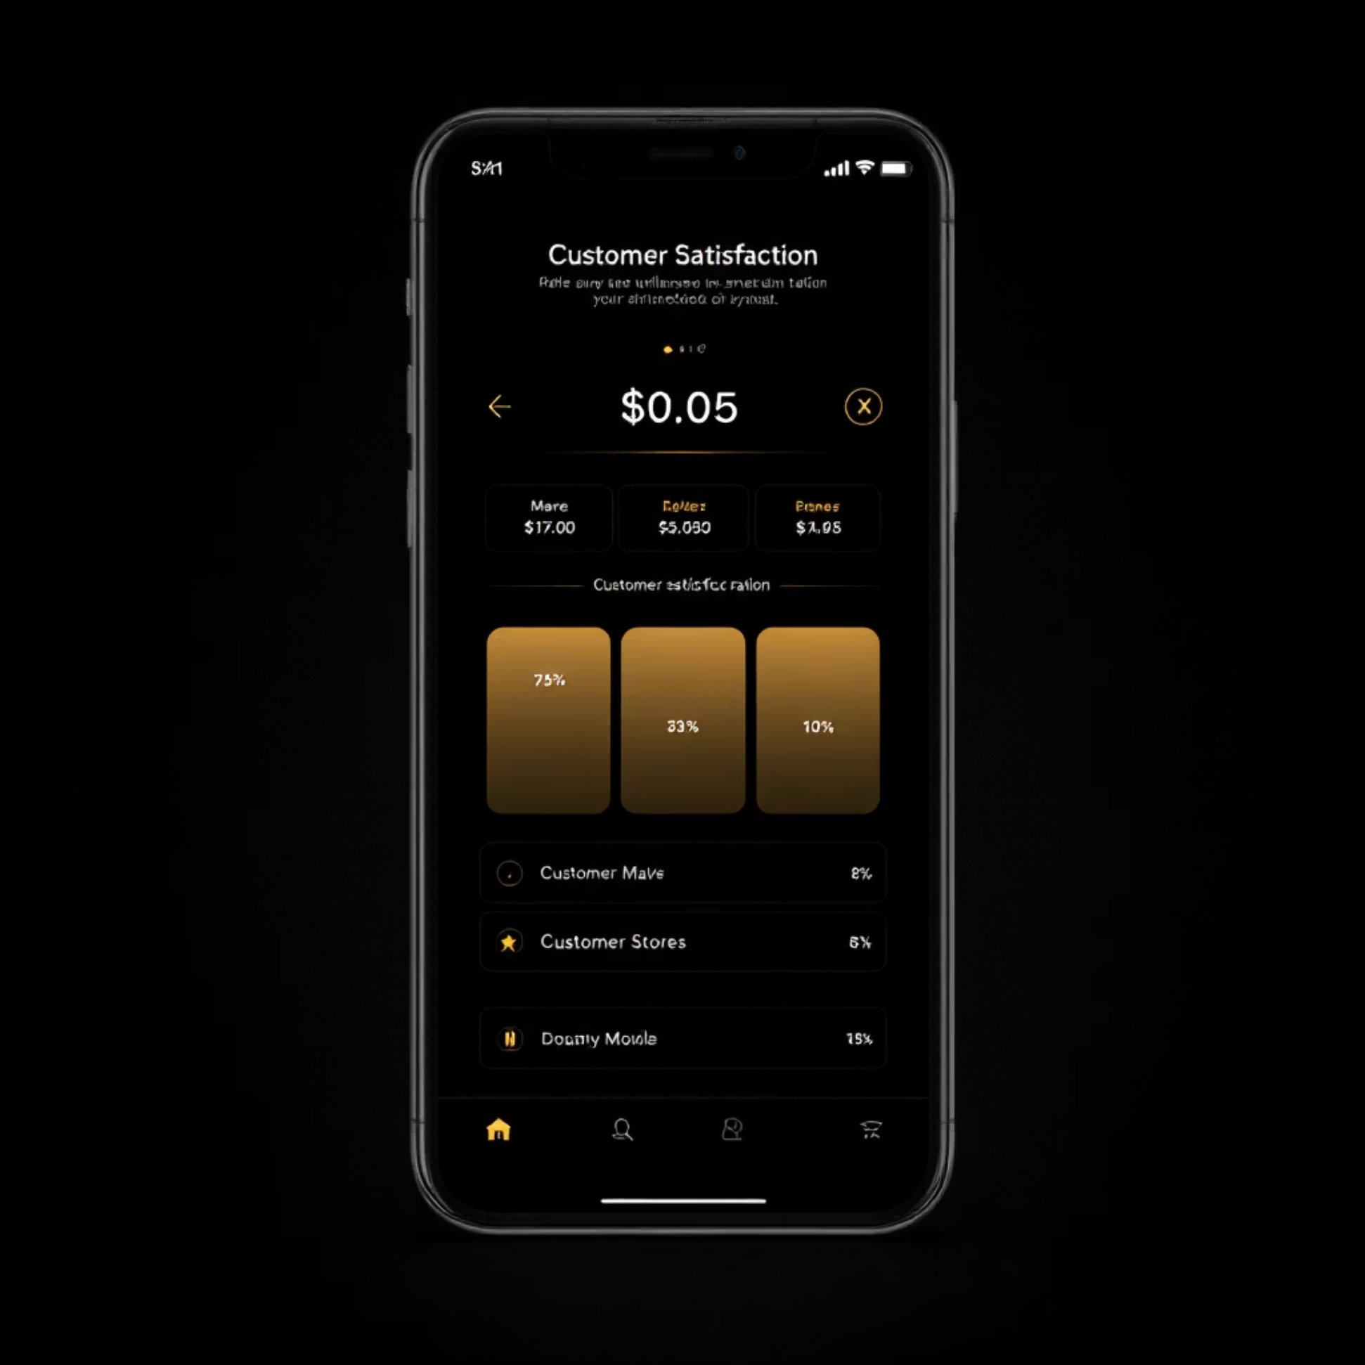
Customer Sentiment Collapse
Rating Trajectory
Customer ratings plummeted from ~4.5 to ~2.6 during the outage period. Negative ratings spiked sharply during the July crisis window.
Most concerning: loyal customers' average ratings also fell, indicating deep frustration among the platform's most valuable users.
The customer funnel showed large churn among previously active and loyal users, representing significant long-term risk.
30%
High-Value Customer Decline
40%
Loyal Customer Churn Risk

Slide 9
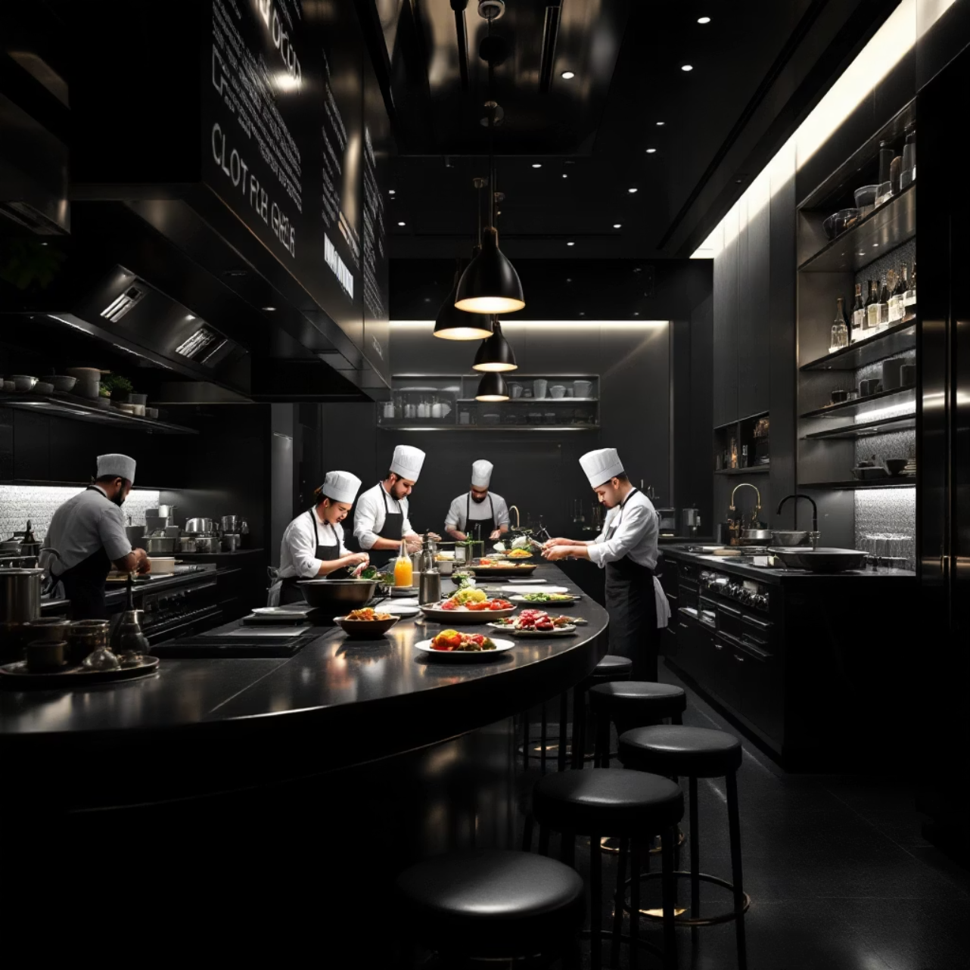
Restaurant Partner Impact
Highest Churn Risk
Cloud kitchens: operational instability
Small single-location outlets
Lower prep-time reliability
Most Stable
Multi-city dine-in chains
Established restaurant brands
Stronger operational resilience

Slide 10

1) Crisis Impact on Orders (June–Sept 2025)
• Orders dropped by ~19.7% vs Jan–May 2025 (≈ 5,000 fewer orders). • Indicates a significant fall in customer demand during the crisis period.
2) City-Level Impact
• Highest decline: UNKNOWN (poorly tagged customer data). • Major metros Delhi, Pune, Hyderabad, Mumbai declined 20–24%. • Crisis impact was broad across Tier-1 & Tier-2 cities, affecting key revenue drivers.
3) Restaurant-Level Insight
• Order volume is highly fragmented across restaurants. • No restaurant met the threshold to be considered high-volume pre-crisis. • Decline analysis for top restaurants could not be performed due to low volumes. • Shows demand is spread thin across many small/low-volume restaurants.
4) Cancellation Rate • Increased slightly from 7.40% → 7.55%, showing mild operational stress. • City-wise breakdown (once added) will identify regions with the highest reliability issues.

Slide 11
5) Delivery SLA Compliance • Mean delivery time rose 5.71 → 5.79 mins, showing minor delays. • Median time stayed constant at 4 mins, meaning only a small subset of orders
experienced delays. • Post-crisis SLA improved significantly, indicating recovery and operational
stabilization.
6) Rating Drop • Sharpest decline in Sept 2025 (–0.03), followed by Apr (–0.025) and
Jun (–0.006). • Declines align with operational disruptions → customer dissatisfaction
increased as delays grew.
7) Customer Sentiment (Keyword Analysis) • Most frequent negative keyword: “late” (1,723 times) → strong delivery
-delay frustration. • Additional themes: “cold,” “stale,” “bad” → food freshness issues. • Indicates delay + quality deterioration were top drivers of negative experience.
8) Revenue Impact
• Crisis led to an estimated ₹3.54M revenue loss (–19.78% vs pre-crisis). • Revenue decline mirrors order decline → lower customer demand was the main driver.

Slide 12
9) Customer Loyalty & Churn
Loyal Customers (5+ orders pre-crisis) • 0% loyalty loss → all high-frequency customers continued ordering
during crisis. • Even customers with high satisfaction (>4.5 rating) did not churn. • Crisis did not disrupt the platform’s core loyal segment.
10) High-Value Customers (Top 5%) • 100% churned during crisis → none placed orders. • Most belonged to major metro cities and preferred high-demand
cuisines (North Indian, Biryani). • They faced longer delivery delays, suggesting reliability breakdown,
not dissatisfaction, caused churn. • Highlights that service reliability is critical for retaining premium customer
segment.

Slide 13
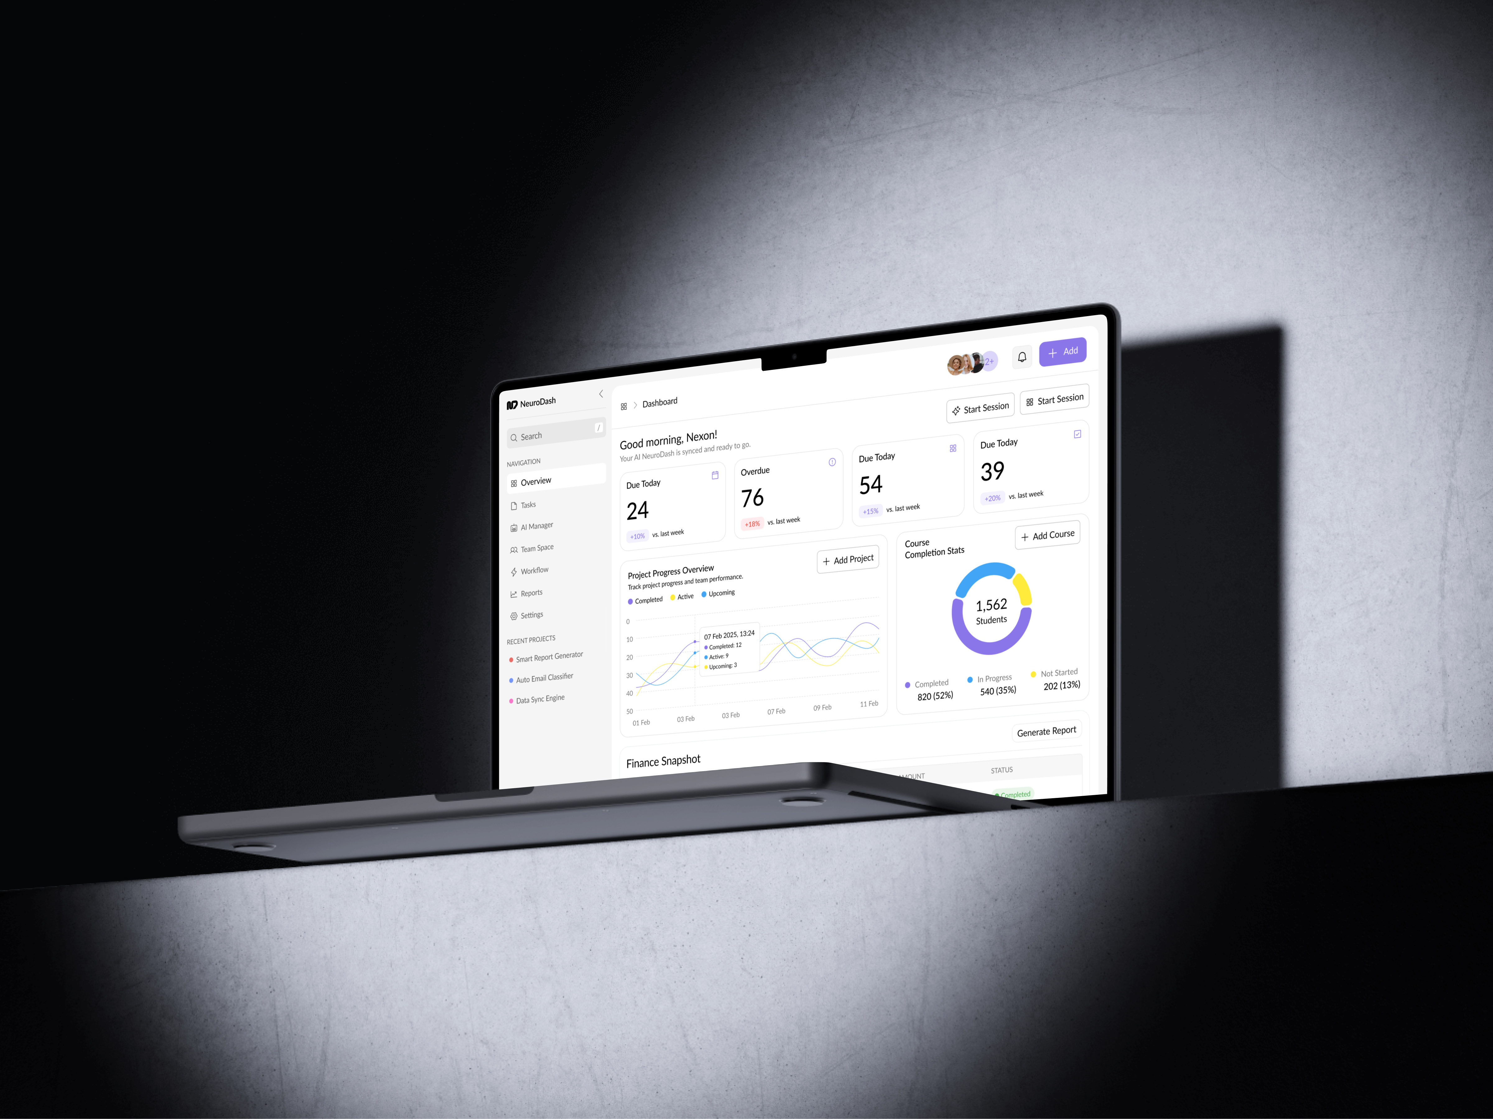
Dashboard Insights
Overall Business Impact
QuickBite suffered a sharp decline in orders, revenue, ratings, and SLA performance during the crisis.
The biggest drop occurred in the crisis phase, with slow recovery in the post-crisis period.
Delivery Performance Breakdown
Avg delivery time spiked, and SLA compliance dropped, directly causing
customer dissatisfaction.
Peak delays aligned with peak cancellations, showing delivery issues were the
root cause.
Longer-distance orders and certain hours of the day saw the worst delays.
Customer Sentiment & Loyalty
Ratings dropped significantly during the outage period, especially
Negative reviews mentioning late delivery and cold food.
Loyal customers (≥5 pre-crisis orders) were heavily impacted —
many became
inactive or churned.
High-rating loyal customers also reduced their purchases.

Slide 14
Orders & Revenue Impact
Both orders and revenue fell sharply, with high-value orders decreasing the most.
Customers shifted to low-value "survival orders", reducing average revenue per order.
Cancellation rates increased, further pulling revenue down.
Restaurant Insights
Cloud kitchens and small brands were the most affected in terms of order decline.
Top restaurants experienced noticeable revenue losses.
City-level performance varied — a few cities showed steep declines and require
priority recovery.
Key Crisis Drivers
Delivery delays
Low SLA %
Increase in cancellations
Negative customer experience
Loyal customer dissatisfaction

Slide 15

Recovery Strategy
01
Operational Reliability
Strengthen delivery partner performance, optimize routes, improve peak-hour fleet
02
Customer Trust Building
Food-safety audits, hygiene badges, transparent communication
03
Targeted Winback
Personalized cashbacks for high-value customers, loyalty rewards, subscription offers
04
Restaurant Partnerships
Reduce commission during recovery, prioritize faster-prep kitchens

Slide 16

Path Forward
30-40% Recovery Potential
Trust Gap Identified
Competitor interest remained stable while QuickBite stagnated during crisis
High-frequency customers with 5+ pre-crisis orders show strong return probability
Focus on Consistency
Restore service reliability to reduce churn and bring CAC under control

